Slide 1
ESNF 607 FINAL PROJECT UML DIAGRAMS Branden Shin (10170759) November 18th, 2020

Slide 2
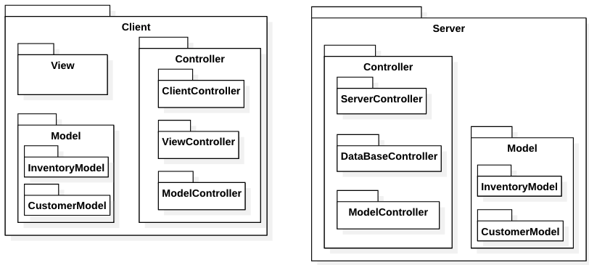



High-Level Package Diagram

Slide 3
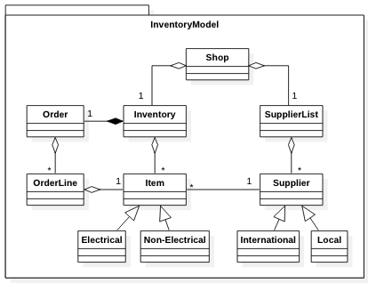
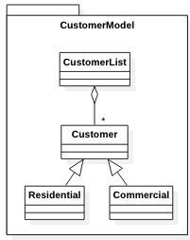
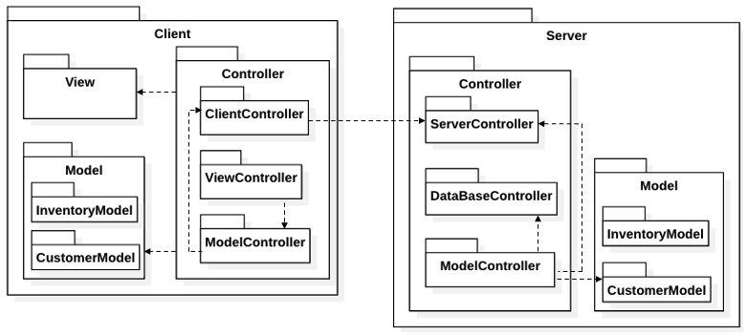


Model Package UML Diagram
This UML diagram is the same for both the Client-Side and Server-Side Model Packages
This UML diagram does not show relationship between the model and controller

Slide 4
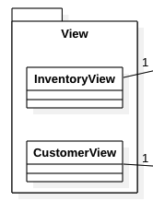
Client-Side View Package UML Diagram
2 views for this system: a view for the Inventory Management System, and another view for the Customer Management System

Slide 5
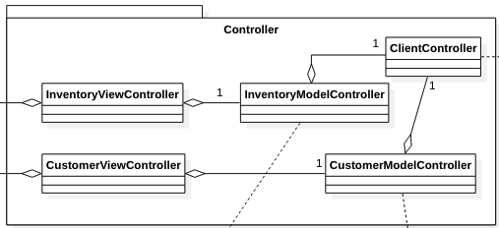






Client-Side Controller Package UML Diagram
Connects to ServerController via socket
We have 1 Client Controller that is used to communicate with the ServerController
We have 2 View Controllers, one for each view
We have 2 Model Controllers responsible for Serialization/Deserialization of objects using a model instance

Slide 6
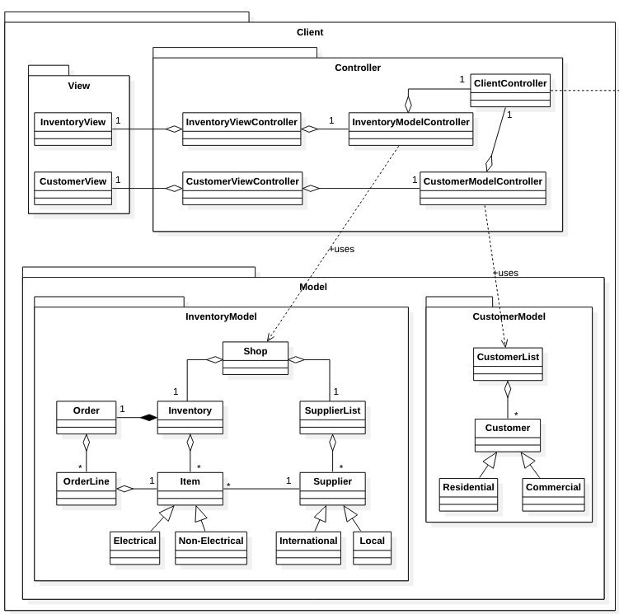
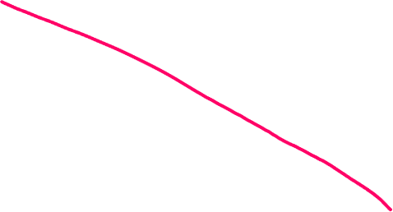

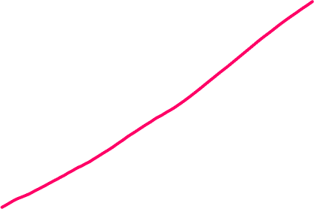
Overall Client-Side UML Diagram
Connects to ServerController via socket
*ModelController uses Model for serialization and deserialization

Slide 7
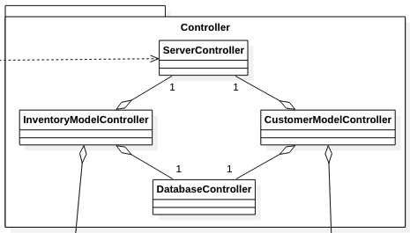


Server-Side Controller Package UML Diagram
Connects to ClientController via socket
We have 1 Server Controller that is used to communicate with the ClientController
We have 2 Model Controllers, 1 for Inventory and one for Client
We have 1 Database Controller to communicate with database

Slide 8
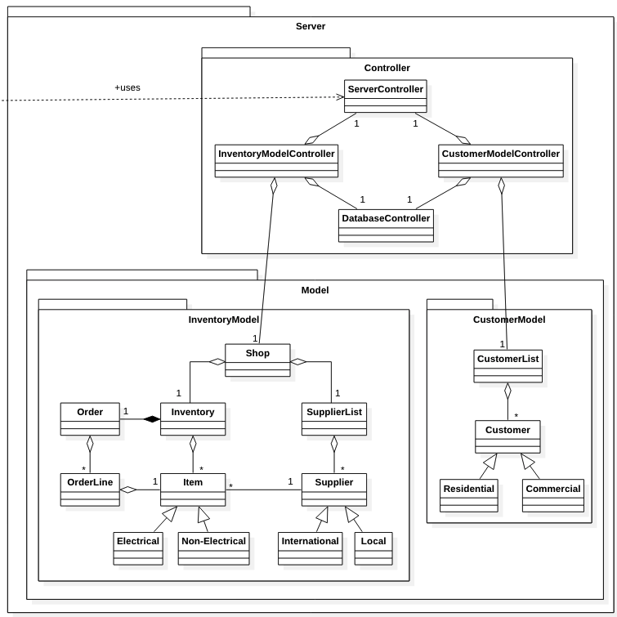
Overall Server-Side UML Diagram
Connects to ClientController via socket

